Slide 1
A World Of Ideas

Slide 2



Slide 3
Globalization and Media: Creating the Global Village by Jack Lule

Slide 4
Marshall McLuhan, The Gutenberg Galaxy (1962) The term global village has been used to express the idea that people throughout the world are interconnected through the use of new media technologies.

Slide 5
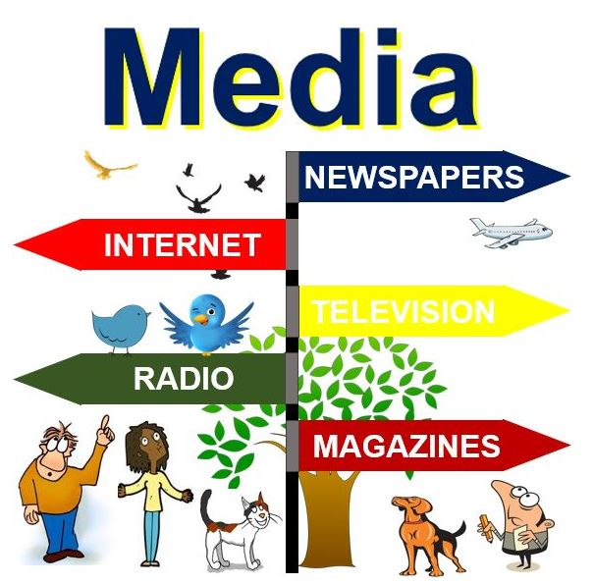
MEDIA
As described as the a means of conveying something ,such as a channel of communication.
are the communication outlets or tools used to store and deliver information or data. The media” began to be used in the 1920s. The various form of media such as television, radio ,newspapers, magazines.

Slide 6

ORAL COMMUNICATION
Speech is often the most overlooked medium in histories in globalization.
Speech has been with us for at least 200,000 years the script for less than 7,000 years, print for less than 600 years and digital technology for less than 50 years.

Slide 7
SCRIPT
the very first writing – allowed humans to communicate and share knowledge and ideas over much larger spaces and across much longer times.

Slide 8
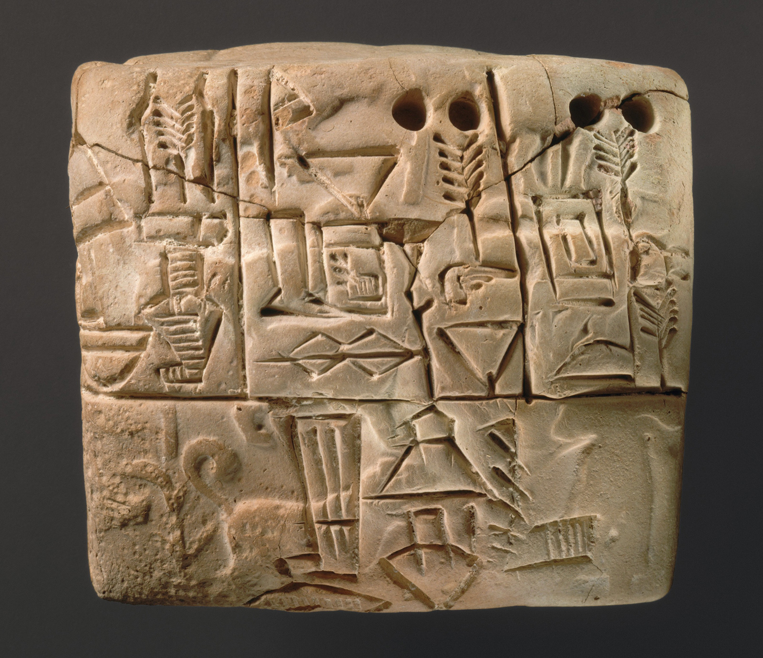
Cuneiform script,
The cuneiform script, created in Mesopotamia, present-day Iraq, ca. 3200 BC, was first. It is also the only writing system which can be traced to its earliest prehistoric origin.

Slide 9

PRINTING PRESS
It’s started the ‘information revolution’and transformed markets,businesses,nation,schools,churches,government,armies and more. The production and copying of written documents were slow,cumbersome and expensive.

Slide 10


Slide 11
Electronic Media
Beginning in the nineteenth century, a host of new media would revolutionize the ongoing processes of globalization. Scholars have come to call these ‘electronic media’ because they require electromagnetic energy – electricity – to use. The telegraph, telephone, radio, film, and television are the usual media collected under
electronic media. The vast reach of these electronic media continues to open up new vistas in the economic, political, and cultural processes of globalization.

Slide 12
No Globalization without Media
The purpose of this section has been to track the development of communication media over time and show how those media were essential to the ongoing processes of globalization. Our starting point was that the human impulse to globalize and the human need to communicate over distance have proceeded together through history, each driving and influencing the other. Even in a condensed summary, the partnership of globalization and media is clear. Each of the eras – oral, script, print, electronic, and digital – saw marked influences of media on globalization. It is difficult to imagine globalization occurring without the media that are
so crucial to human life.

Slide 13
MEDIA AND ECONOMIC GLOBALIZATION

Slide 14

DIGITAL MEDIA
Digital media are most often electronic media that rely on digital codes – the long arcane combinations of 0s
and 1s that represent information. Many of our earlier media, such as phones and televisions, can now be
considered digital. Indeed, digital may even be blurring the lines among media. If you can watch television, take
photographs, show movies, and send e-mail on your smartphone or tablet, what does that mean for our neat
categorization of media into television, film, or phone? The computer, though, is the usual representation of
digital media. The computer comes as the latest and, some would argue, most significant medium to influence
globalization.

Slide 15

Global Imaginary and Global Village
In this perspective, the media have not only physically linked the globe with cables, broadband, and wireless networks, but have also linked the globe with stories, images, myths, and metaphors. The media are helping to bring about a fundamentally new imaginary, what scholar Manfred Steger (2008) has called a rising global imaginary – the globe itself as the imagined community. In the past, only a few, privileged people thought of themselves as ‘cosmopolitan’ – citizens of the world. Cosmopolitanism is now a feature of modern life. People imagine themselves as part of the world.

Slide 16
The media have been essential to the growth of economic globalization in our world. Indeed, the media have
made economic globalization possible by creating the conditions for global capitalism and by promoting the
conceptual foundation of the world's market economy. Economic globalization, from this perspective, is not just
dollars and cents, but story and myth – narratives that make natural the buying and selling of products across
borders and boundaries and mythic celebrations of products and consumption.

Slide 17
NO NEWS TODAY

Slide 18
Transnational conglomerates, in this view, are much less interested than local media outlets in providing news and information necessary for citizens. People are encouraged to think of products, not politics. They are consumers, not citizens. The conglomerates have little incentive to invest in local talk shows, news channels, documentaries, or other social and political content. The global oligopoly of media thus helps create a passive apolitical populace that rises from the couch primarily for consumption.

Slide 19

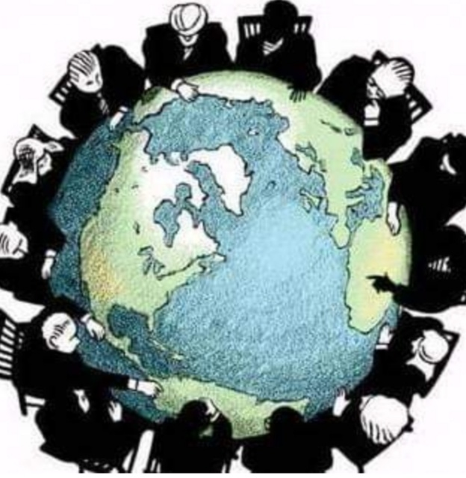
MEDIA AND POLITICAL GLOBALIZATION
An essential process of globalization is political. Globalization has transformed world politics in profound ways.
It led to the formation and then the overthrow of kingdoms and empires. It led to the creation of the nation-state.
And now some argue that the nation-state is being weakened as people and borders become ever more fluid
in our globalized world. Some argue that transnational political actors, from NGOs (non-governmental
organizations) like Greenpeace to corporations to the United Nations, now rise to prominence in our age of
globalization. When we add the media to the admixture of globalization and politics, we touch upon some key
features of modern life.

Slide 20
MEDIA AND CULTURAL GLOBALIZATION
The media, on one level, are the primary carriers of culture. Through newspapers, magazines, movies, advertisements, television, radio, the Internet, and other forms, the media production and display cultural products, from pop songs to top films.

Slide 21
Dark Contours of Global Village
Globalization and media have done wondrous deeds. They have succeeded in bringing the world closer together. They have removed the shackles of time and space. They have given us the ability to truly imagine the world as a global village. When McLuhan first conceived the term, he had the highest hopes and, even today, the term global village still evokes community, kinship, cooperation, and fraternity. But Lewis Mumford was not fooled. His cold, clear vision of human weakness saw emerging the dark contours of the global village. He saw media technology used not to better the world but to exploit the world in pursuit of property, profit, and power.

Slide 22
Popular Music and Globalization by Yara El-Ghadban

Slide 23
Qualifying music as popular is a value judgment indicating the important place music occupies in everyday life, as a highly subjective aesthetic experience, as an essential part of shared social activities, as a mediated and mass-produced cultural product and as a means for engagement with power and with Otherness (Harrington
and Bielby, 2001). When examined through the prism of contact, friction, and capital, popular music is, therefore, better understood as an umbrella term encompassing a wide variety of genres, practices, and meanings that go beyond its general association with Anglo-American inspired pop culture.

Slide 24
Popular Music and Musicians in Society: From the Local to the Global

Slide 25
When the terms globalization and music are put together, they tend to conjure up critical reflections regardingthe notions of culture, place, and identity. They also underline anthropological and ethnomusicological understandings of music making as an important catalyst in the generating of various representations and ideologies associated with such notions. Indeed, music participates at once in the reinforcing of boundaries of culture and identity and in subverting them. It is no surprise, then, that music should be just as implicated in subject formation and identity politics, particularly in ‘playing out’ a sense of common nationhood or belonging in a context marked by uneven transnational social, cultural, political and economic transactions. Taking that into account, popular music makes a compelling case for elucidating the complex dynamics of globalization, not only because it is popular, but because music is highly mediated, is deeply invested in meaning, and has proven to be an extremely mobile and resourceful form of capital.

Slide 26
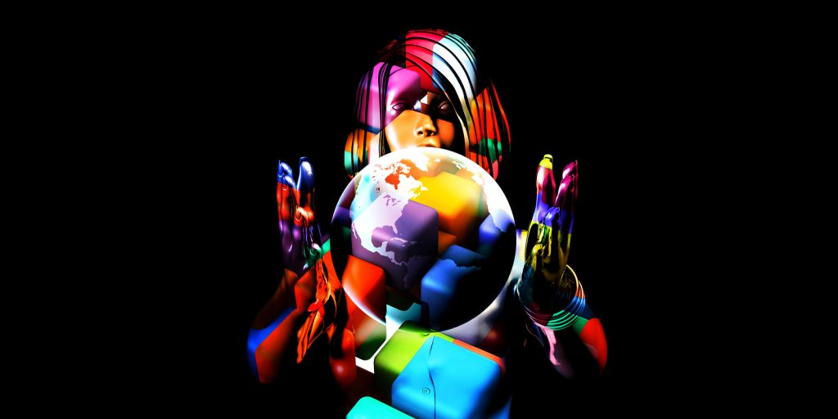
Contact: Re-Reading the History of Music and Globalization

Slide 27
Globalization, as we know it today, that is, as the compression of time and space through the flow of people and capital, has been part of human history for centuries. The discovery of the new world and the following European expeditions of the sixteenth century tend to be referred to as a marker
These contacts do not fit into the Eurocentric map inherited the sixteenth century from cartographers such as Gerardus Mercator. They are therefore often neglected in contemporary histories of globalization, which tend to focus on a polarized north–south, east–west axis pitting civilizations with fundamentally different world-views against each other.
Example of friction in music is the minstrel shows that became immensely popular in the northern regions of the United States during the nineteenth century, where contact with black people was rare prompting mixed feelings of fear and fascination with the life and customs of the slaves who worked in the South’s cotton plantations. White actors painted their faces black and performed theatrical numbers based on caricaturized archetypes of black people as they imagined them (Small, 1987). Often cited as emblematic examples of the perversion of black identity and racism, the minstrels were also the product of class conflicts through which race and racism, as Stuart Hall reminds us, were mobilized (Hall and Jefferson, 1976). Indeed, the actors who performed in these shows were themselves part of a poor white underclass, many of whom had migrated to the United States as indentured workers. They were in fact not much better off than the black slaves.

Slide 28
Capital: The Technologies and Ethics of World Music

Slide 29
Legend has it that ‘world music’ came to be as a label in 1987 following a series of meetings by music industry actors in the United Kingdom in order to decide on how to identify and then market a growing number of recordings fusing Western and different types of non-Western musics that defied the categories of genre that were established
In their critique, both underline the interplay of capital with historical inequalities and violent encounters as central to the making and marketing of world music.As such, world music as capital does not only concern globalization’s consuming cosmopolitan elite but also the music makers themselves. It raises ethical questions of opportunity versus exploitation, mutuality, and reciprocity versus hegemony. Much like African-American music, it also continues to provoke debate around identity, authenticity, pluralism and belonging which have divided scholars, industry actors, consumers and music makers alike

Slide 30
Today, technologies of transport, of information and of mediation,including social media platforms, have made
possible the unprecedented circulation of cultural commodities such as music from around the world, which are
then consumed to gain cultural capital and social status. In terms of music, such dynamics may reinforce
unequal relations of power, leading to hegemony and homogenization just as they may provide possibilities of
subverting them resulting in the emergence of entropic forms of musical expression that had not been imagined
before. The histories of musical interactions throughout the Indian Ocean and the Muslim empire from the ninth
onto the nineteenth century, as well as between Europe, the Middle-East, and East Asia illustrate how these
encounters occurred over a period of centuries.

Slide 31
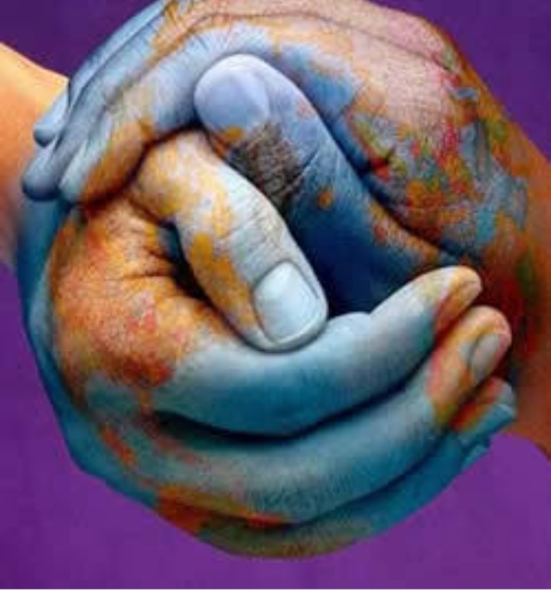
Religion and Globalization by Victor Roudometof

Slide 32
it offers an overview of the various disciplinary and interdisciplinary fields and the ways these have responded and contributed to the problematic of globalization. The discussion focuses more closely in the field of sociology of religion, where the dominance of the secularization paradigm comes under scrutiny. The next section expands into contemporary issues and research agendas that interrogate the relationship between religion and globalization and presents different interpretations of this relationship. In the final section, two relatively recent research agendas are presented: transnational religion and the relationship between religion and culture. By way of introduction, it is critically important that the reader is aware that this chapter does not attempt to capture the totality of contemporary scholarly agendas that pertain to the study of religion as such.

Slide 33
Cross-Disciplinary Considerations: Beyond the Secularization Debate –
The study of religion is an inter- or ‘cross-disciplinary area of inquiry (Crawford, 2001). As such, it has not always been successfully incorporated into social scientific disciplines. Hinnells’s (2010: 6) statement that ‘sociology, psychology, history, philosophy departments in the twentieth and twenty-first centuries have moved religious studies towards the margins of their subject”’ is telling

Slide 34
Globalization: Perspectives from the Field

Slide 35
This chapter has offered a brief overview of scholarship that has specifically focused on the relationship between religion and globalization. The chapter has highlighted the extent to which some of these contributions have had the broader appeal beyond the field of religion and into the broader social-scientific community of researchers interested in the topic of globalization. Broadly speaking, research agendas have focused both on the spread of religious traditions into new territories as well as on new developments within existing religions spearheaded by globalization. Obviously, no comprehensive account of all individual articles and studies can be made within the existing space restrictions. Still, the chapter has specifically referred to key contributions in the field and has stressed the degree to which historically oriented and cross-cultural scholarship on the relationship between religion and globalization represents an important area of current research. Such work allows the field to transcend its traditional roots in the study of Christianity
and in Western modernization and to grow by attempting to engage diverse historical eras and cultural contexts

Slide 36
CONCLUSION

Slide 37
Religion in Global Conflict by Mark Juergensmeyer

Slide 38
In the last decades of the twentieth century and the beginning of the twenty-first, religion has often been in the news, and when it has, it has been bad news. The rise of xenophobic right-wing Christians in Europe and the United States, the emergence of Hindu nationalism in India, extreme Jewish political movements in Israel, Buddhist confrontations in Sri Lanka and Thailand, and radical Muslim movements throughout the Middle East have branded all religious traditions as potential conveyors of strident political activism.
However, if one means by ‘religion’ a set of doctrines and beliefs. The conflicts have been about identity and economics, about privilege and power – the things that most social conflicts are about. When these conflicts are religionized when they are justified in religious terms and presented with the aura of sacred combat – they often become more intractable, less susceptible to a negotiated settlement.

Slide 39
Revolt Against Global Secularism

Slide 40
Secular authorities treated these rebellious religious movements simply as attempts to usurp power. The secular leaders left unchallenged the moral critique that the movements conveyed. In the early months of the Iranian revolution, for instance, some American scholars refused to accept it as genuine. They thought it was only an unfortunate interruption of the historical process that they believed had been leading Iran inexorably toward a Western-style liberal political system. In India, Indira Gandhi scoffed at the pretensions of the young Sikh leaders who challenged her authority, and she refused to take them seriously. Yet at the same time, within the general public in South Asia, Iran, and the Middle East many people began to accept as valid certain aspects of these movements’ moral critique. In some cases, they regarded the new religious activists as versions of the legendary Robin Hood – extra-legal though virtuous challengers to the political status quo.

Slide 41
Internationalization of Religious Rebellion

Slide 42
The next stage of the developing warfare between religious and secular politics was the internationalization of the conflict in the 1980s. This stage is best represented by the ad hoc international coalition of jihadi Muslim radicals that developed in the Afghan war. It is hard to underestimate the formative power of their experience, shared by thousands of volunteer soldiers in the Afghanistan struggle against the Soviet regime in the 1980s. In one central theatre of involvement, activists were brought together from throughout the Muslim world. The fighting force of mujahadin included erstwhile jihadi soldiers who came from Muslim countries from Pakistan to Northern Africa. It also included some of the Egyptian militants linked to Sadat’s assassination and Saudis who would later be identified with the al Qaeda movement of Osama bin Laden. Afghanistan became the crudecadefor creating the international Muslim political networks that would infuriate global politics for the next two decades.
Early in the 1980s international developments also affected the Jewish religious politics of Israel, which in turn would help to spur the growth of Muslim movements in Israeli controlled Palestine and the adjacent region. The enormous victory of Israel in 1967 over its Arab neighbors had been a point of pride for the young nation of Israel, and it also helped to stimulate new thinking about a broader role for the nation both geographically and theologically (see Sprinzak, 1991).

Slide 43
The invention of Global Enemies

Slide 44
The third stage in the gathering cold war between religious and secular politics was characterized by a growing anti-American and anti-European sentiment in the 1990s. In this stage, the target of the religious activists’ wrath shifted from local regimes to international centers of power
The 1990s constituted a decade of social dissent linked with religious traditions of various kinds: Christianity, Judaism, and Buddhism as well as Islam of both Sunni and Shi’ite varieties. America was regarded as the fount of secularism and hence often the target. Many who attacked it were incensed by what they regarded as its economic, cultural and political oppression under the ‘new world order’ of a secular, America-dominated, postCold War globalized world
There was also an indirect relationship between the end of the old Cold War and the rise of the new religious rebellions. The collapse of the global polarity between communism and capitalism meant that the West was the sole remaining superpower, but it also left the perception that superpowers were flawed bastions, and could crumble and fall. At the same time, America and Europe’s economic superiority was being challenged by the rise of the East Asian economy, and America’s moral authority was under question after Vietnam and the Watergate scandal

Slide 45
GLOBAL WAR

Slide 46
The first decade of the twenty-first century saw an increasing expansion in the scope of the imagined contestation between secular and religious forces, seen increasingly in a global frame of reference. The significant moment in this development was 11 September 2001. Though most of the 19 hijackers who boarded the four commercial airplanes involved in the attacks on the World Trade Center and the Pentagon on that fateful day were Saudis, the planning for the conspiracy was global. It involved scores of activists in multiple countries from Afghanistan to Germany to the United States. Moreover, the goals of the jihadi networks were increasingly transnational. Originally jihadi leaders like Khalid Shaikh Mohammad and bin Laden had been fixated on local issues – in bin Laden’s case, on Saudi Arabia. He was concerned especially about the role of the United States in propping up the Saudi family and, in his mind, America’s exploitation of the oil resources of the country. He then adopted a broader critique of Middle Eastern politics, following the general jihadi perspective of Maulana Maududi, Sayyid Qutb and other Muslim political thinkers who rejected all forms of Western political and social influence in the region. Increasingly the goal of bin Laden’s and the other jihadi activists was not just to get American influence out of Saudi Arabia but out of the whole Muslim world. This meant a confrontation of global proportions on multiple fronts.

Slide 47
RELIGIOUS DIMENSIONS POST ARAB SPRING
Religion provides a sense of empowerment and this often relates to violence. Understanding the role of religion might explain modern acts of terrorism and religion violence.
The nature of islam is to defend dignity and honor. That is why dying because of suicide booming is better for them than to live everyday in humiliation. Dying this way make them feel dignified. Religion and violence is viewed as antidote for humiliation.ght
symbolic religious movements which are violent are taken just for the issue to be taken by the government seriously. Nakamura,1996)gion

Slide 48
According to jurgensmeyer( 2013), symbolic empowerment doest not mean that the empowerment is not real. A sense of power has a great impact on community and even to themselves. But violence is only empowering in a different way as it it done for a great cause in ordinary military terms.
The point of committing religious violence is for a greater reason which is to produce graphic and easily understandable object lesson. It is analyzed as any other symbol or sacred drama.
Religious violence is both about violence and religion. It is a religion because that it is a calling for them to a violent attack and to give meaning to their life.lesson.

Slide 49
Religious Resurgence in an Era of Globalization

Slide 50
Because religious ideas, values, symbols, and rites related to the deep issues of existence, it should not be surprising when religion enters the picture in times of crisis. The era of globalization is certainly one of those moments of social crisis, although in this case, one experienced on a global scale. This is why the response has been virtually global as well.
The era of globalization brought with it three enormous problems. The first was identity, how societies could maintain a sense of homogeneity when ethnic, cultural, and linguistic communities were spread across borders, in many cases spread across the world. The second problem was accountability, how the new transnational economic, ideological, political and communication systems could be controlled, regulated, and brought to justice. The third problem was one of security, how people buffeted by forces seemingly beyond anyone’s control could feel safe in a world increasingly without cultural borders or moral standards
Critics of religion may observe that all of these religious solutions are illusory. It is a sense of identity, accountability, and security that religion offers, not solutions that are grounded in an enduring reality. The critics may be correct. But for the moment the religious imagination provides a way of coping with the extreme problems of globalization. It also gives a motivation for engaging in conflicts related to global pressures and images of cosmic war that enlarge social conflict into the realm of the transcendent and give meaning to those who struggle not just as rebels but as sacred soldiers. To enter into such global conflicts transcends all of the complications imposed by the new realities of a globalized world.

